Slide 1
Docker
14-Sep-2018

Slide 2

Noticeable Challenges and Trends
AGENDA
01
Docker Introduction
02
03
04
QA
04
08

Slide 3
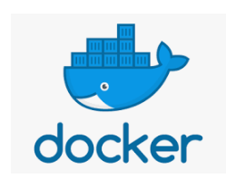

Slide 4
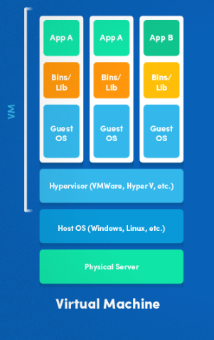
What is Virtualization
Virtualization is the technique of importing/hosting a Guest operating system on top of a Host operating system.
Advantages
Multiple operating systems can run on the same machine
Maintenance and Recovery were easy in case of failure conditions
Total cost of ownership was also less due to the reduced
need for infrastructure

Slide 5
What is Containerization
Containerization is the technique of bringing virtualization to the operating system level.
While Virtualization brings abstraction to the hardware, Containerization brings abstraction to the operating system. Do note that Containerization is also a type of Virtualization.
Containerization is however more efficient because there is no guest OS here and utilizes a host’s operating system, share relevant libraries & resources as and when needed unlike virtual machines.
Application specific binaries and libraries of containers run on the host kernel, which makes processing and execution very fast.
Even booting-up a container takes only a fraction of a second.
Because all the containers share, host operating system and holds only the application related binaries & libraries. They are lightweight and faster than Virtual Machines.

Slide 6
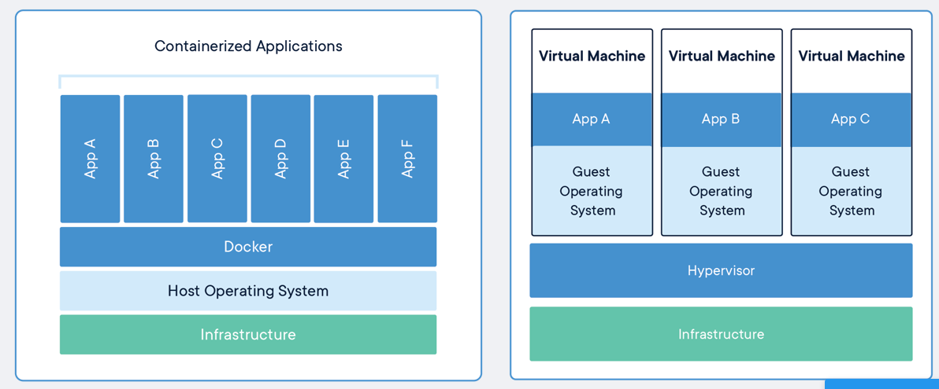
VM vs Containerization
Containers and virtual machines have similar resource isolation and allocation benefits, but function differently because containers virtualize the operating system instead of hardware. Containers are more portable and efficient.

Slide 7
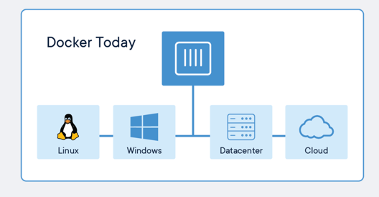
Introduction to Docker
Docker container technology was launched in 2013 as an open source Docker Engine.
It leverages existing computing concepts around containers and specifically in the Linux world, primitives known as cgroups and namespaces
Docker Containers Are Everywhere: Linux, Windows, Data center, Cloud, Serverless, etc.

Slide 8
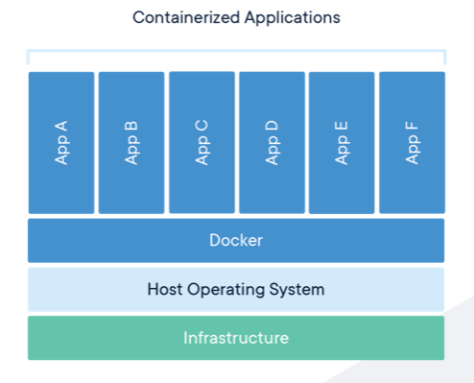
Introduction to Containers
A container is a standard unit of software that packages up code and all its dependencies so the application runs quickly and reliably from one computing environment to another.
A Docker container image is a lightweight, standalone, executable package of software that includes everything needed to run an application: code, runtime, system tools, system libraries and settings.

Slide 9
Introduction to Docker
Docker is a platform for developers and sysadmins to develop, deploy, and run applications with containers.
The use of Linux containers to deploy applications is called containerization. Containers are not new, but their use for easily deploying applications is.
Containers are Preferred because
Flexible: Even the most complex applications can be containerized.
Lightweight: Containers leverage and share the host kernel and therefore do not require OS per app.
Interchangeable: You can deploy updates and upgrades on-the-fly.
Portable: You can build locally, deploy to the cloud, and run anywhere.
Scalable: You can increase and automatically distribute container replicas.
Stackable: You can stack services vertically and on-the-fly.
Secure: Docker provides the strongest default isolation capabilities in the industry

Slide 10
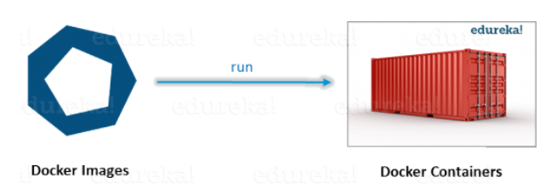
An image is an executable package that includes everything needed to run an application--the code, a runtime, libraries, environment variables, and configuration files.
A container is a runtime instance of an image--what the image becomes in memory when executed (that is, an image with state, or a user process).

Slide 11
Docker Daemon - The background service running on the host that manages building, running and distributing Docker containers. The daemon is the process that runs in the operating system to which clients talk to.
Docker Client - The command line tool that allows the user to interact with the daemon. More GUI Client Kitematic which provide a GUI to the users.
Docker Hub - A registry of Docker images. You can think of the registry as a directory of all available Docker images. If required, one can host their own Docker registries and can use them for pulling images.
Base images are images that have no parent image, usually images with an OS like ubuntu, busybox or debian.
Child images are images that build on base images and add additional functionality.
Official images are images that are officially maintained and supported by the folks at Docker. These are typically one word long. In the list of images above, the python, ubuntu, busybox and hello-world images are official images.
User images are images created and shared by users like you and me. They build on base images and add additional functionality. Typically, these are formatted as user/image-name.

Slide 12
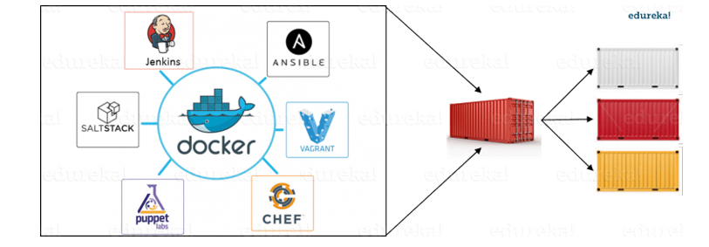
CI/CD Integration with Docker

Slide 13
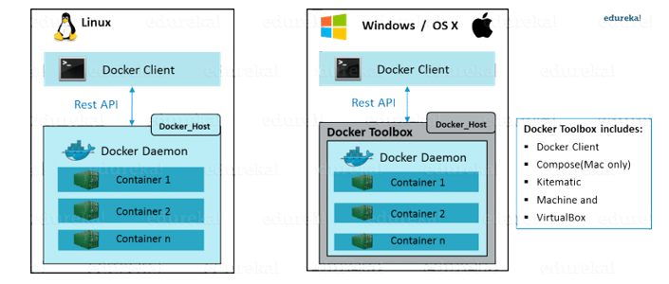
What is Docker Engine
Docker Engine is simply the docker application that is installed on your host machine. It works like a client-server application which uses:
A server which is a type of long-running program called a daemon process
A command line interface (CLI) client
REST API is used for communication between the CLI client and Docker Daemon

Slide 14
Overview of Docker Editions
Docker is available in two editions:
Community Edition (CE)
Enterprise Edition (EE)
Docker Community Edition (CE) is ideal for individual developers and small teams looking to get started with Docker and experimenting with container-based apps.
Docker Enterprise Edition (EE) is designed for enterprise development and IT teams who build, ship, and run business critical applications in production at scale.

Slide 15
Choosing Docker vs VM
Do you need to run multiple copies of a single application (e.g, PostgreSQL, MySQL)? If yes, choose Docker.
Are you OK with using one OS version for your application? If yes, choose Docker.
Do you need to run as many applications as you can on a limited hardware budget? If yes, choose Docker.
Do you need multiple (or obscure) OS’es? If yes, go with a VM.

Slide 16
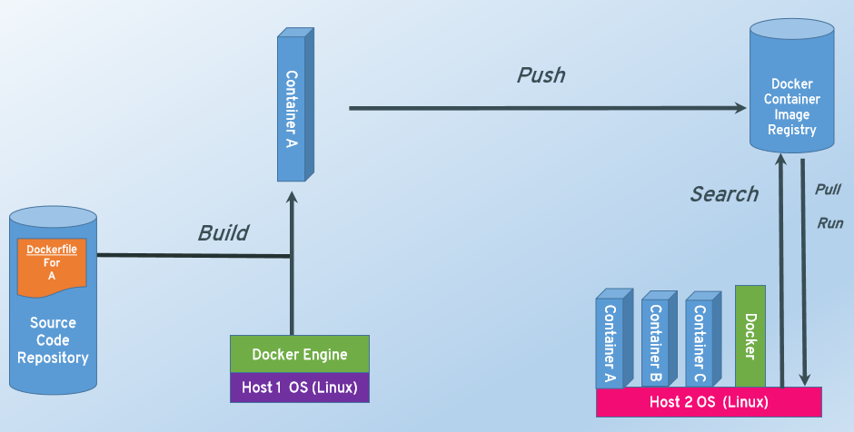
Basics of Docker System

Slide 17
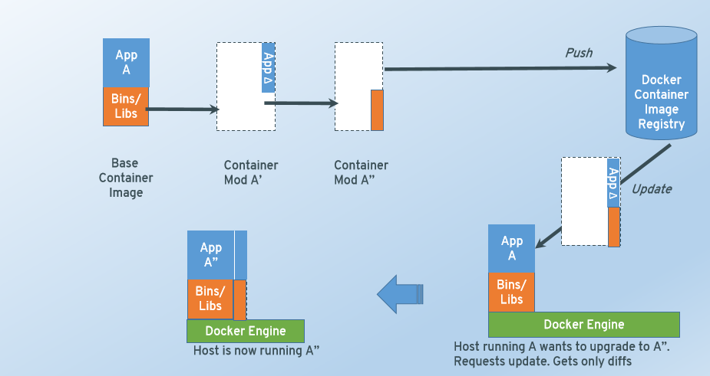
How the Updates work in Docker

Slide 18
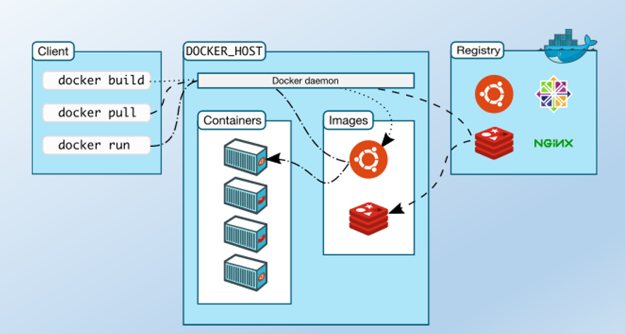
Docker Architecture

Slide 19
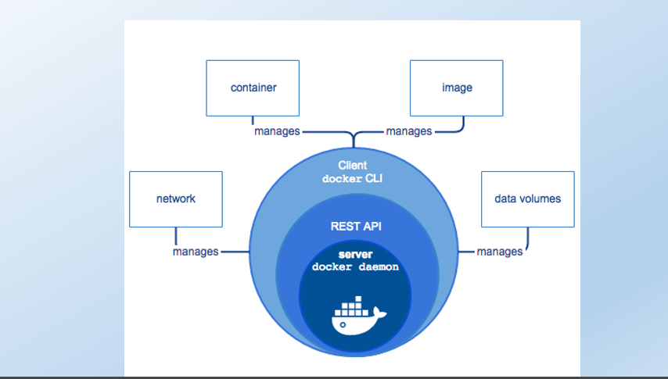
Docker Engine
Docker daemon, a REST API that specifies interfaces for interacting with the daemon,
command line interface (CLI) client that talks to the daemon (through the REST API wrapper).
Docker Engine accepts docker commands from the CLI, such as docker run <image>, docker ps to list running containers, docker image ls to list images, and so on.

Slide 20
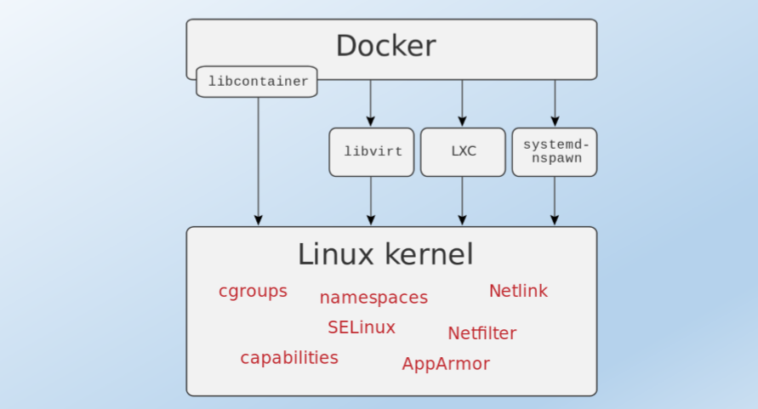
Docker Architecture

Slide 21
Namespaces and Control Groups
Docker takes advantage of a technology called namespaces to provide the isolated workspace.
When you run a container, Docker creates a set of namespaces for that container.
1. The pid namespace : Process isolation (PID:ProcessID).
2. The net namespace: Managing network interfaces (NET: Networking).
3. The ipc namespace: Managing access to IPC resources (IPC: Inter Process Communication).
4. The mnt namespace :Managing mount-points (MNT:Mount).
5. The uts namespace: Isolating kernel and version identifiers. (UTS: Unix Timesharing System)
Control groups allow Docker Engine to share available hardware resources to containers and, if required, set up limits and constraints.

Slide 22
Dockerfile
Docker can build images automatically by reading the instructions from a Dockerfile.
A Dockerfile is a text document that contains all the commands a user could call on the command line to assemble an image.
Using docker build users can create an automated build that executes several command-line instructions in succession.
The docker build command builds an image from a Dockerfile and a context.

Slide 23
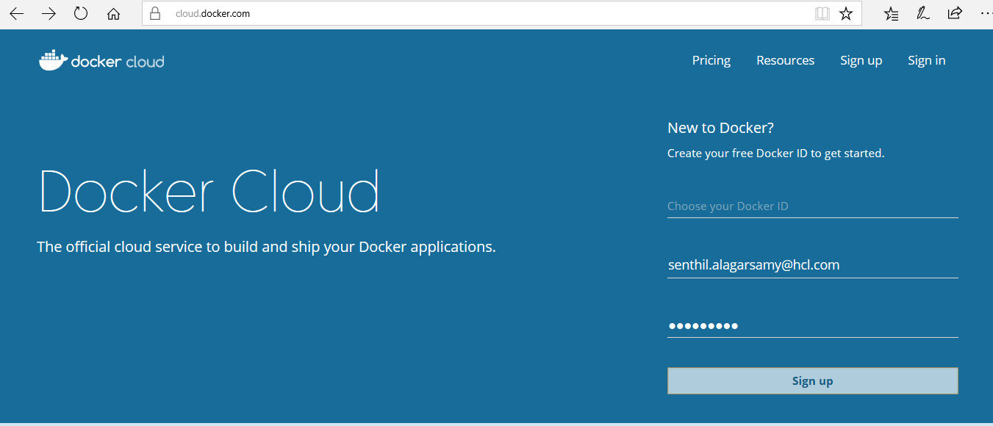
Docker Store Overview
Independent Software Vendors (ISVs) can utilize Docker Store to distribute and sell their Dockerized content.
Products are published and maintained directly by a commercial entity.
Docker Certified logo distinguishes content by providing quality, provenance, and support assurances.

Slide 24
Docker Hub Overview
It’s a cloud-based registry service which allows you to link to code repositories, build your images and test them, stores manually pushed images,
Links to Docker Cloud so you can deploy images to your hosts.
It provides a centralized resource for container image discovery, distribution and change management, user and team collaboration, and workflow automation throughout the development pipeline.
Image Repositories: Find and pull images from community and official libraries, and manage, push to, and pull from private image libraries to which you have access.
Automated Builds: Automatically create new images when you make changes to a source code repository.
Webhooks: A feature of Automated Builds, Webhooks let you trigger actions after a successful push to a repository.
Organizations: Create work groups to manage access to image repositories.
GitHub and Bitbucket Integration: Add the Hub and your Docker Images to your current workflows.

Slide 25
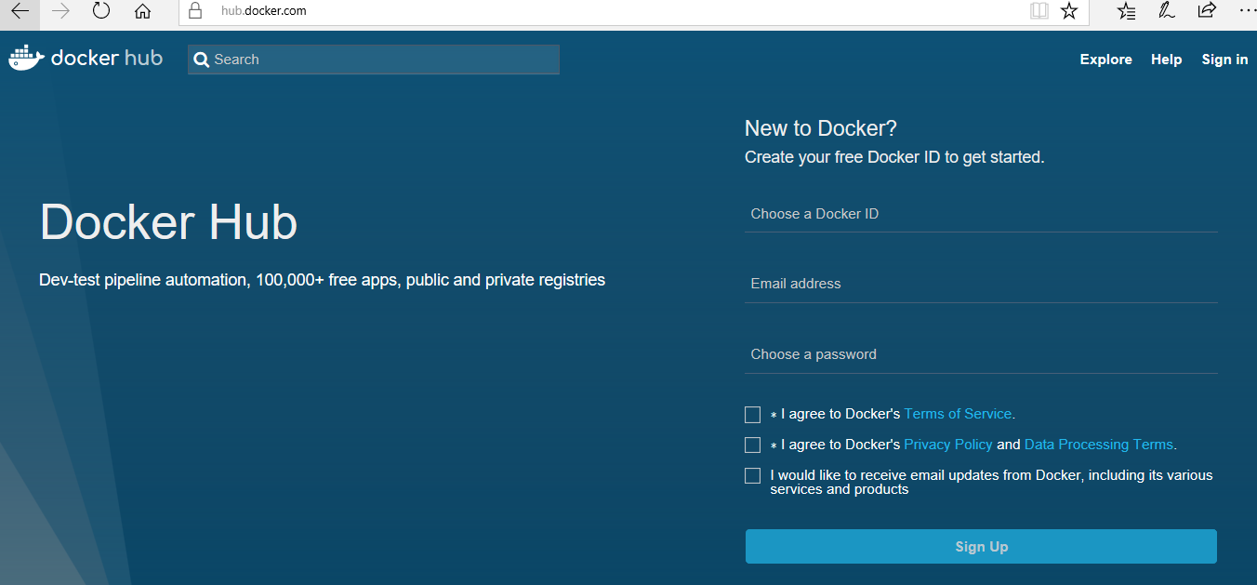
Docker Hub

Slide 26
Docker Hub vs Docker Store
Docker Hub and Docker Store leverage the same backend, the Docker Public Registry.
In general, all publicly available community content should be visible via both Docker Hub and Docker Store, and this includes official images.
Any content that has explicitly been added by a commercial entity and has gone through a vetting process with respect to content submission and best practices, is only available on Docker Store.

Slide 27
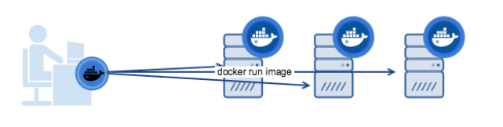
Docker Machine
Docker Machine is a tool that lets you install Docker Engine on virtual hosts, and manage the hosts with docker-machine commands.
docker Machine has its own command line client docker-machine and the Docker Engine client, docker.
You can use Machine to install Docker Engine on one or more virtual systems.
These virtual systems can be local (as when you use Machine to install and run Docker Engine in Virtual Box on Mac or Windows) or remote (as when you use Machine to provision Dockerized hosts on cloud providers).
The Dockerized hosts themselves can be thought of, and are sometimes referred to as, managed “machines”.

Slide 28
Docker Compose
Compose is a tool for defining and running multi-container Docker applications.
you use a YAML file to configure your application’s services.
Then, with a single command, you create and start all the services from your configuration.
Compose works in all environments: production, staging, development, testing, as well as CI workflows.
Using Compose is basically a three-step process:
Define your app’s environment with a Dockerfile so it can be reproduced anywhere.
Define the services that make up your app in docker-compose.yml so they can be run together in an isolated environment.
Run docker-compose up and Compose starts and runs your entire app.

Slide 29
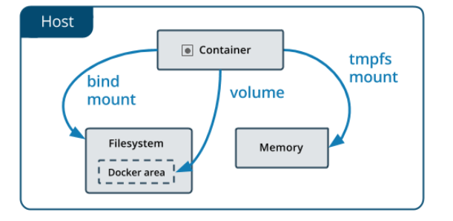
Docker Volumes

Slide 30
Docker Commands
Verify Docker Version
First important task while working Docker containers is to know your Docker version, Use below command to know your docker version
[root@docker ~]# docker --version
Docker version 17.03.1-ce, build c6d412e
[root@docker ~]#
View system wide Information
‘docker info‘ command is used to view the system wide information like Docker’s root Directory, OS version, Kernel Version,
Docker Version, RAM, CPU and Docker Registry.

Slide 31
Docker Commands
Search Docker Images in its Registry Server
With help of ‘docker search‘ command we search the docker container images in registry server from the terminal,
[root@docker ~]# docker search debian
Downloading Docker Container Images
we can download docker container images from its registry server or repository.
Syntax : # docker pull <Name-of-Image>
Docker pull command always download latest version of image, though we can specify the particular of image.
[root@docker ~]# docker pull debian

Slide 32
Docker Commands
Downloading Specific OS version Docker Image
To download Ubuntu:14.04 Docker Image
[root@docker ~]# docker pull ubuntu:14.04
List all Downloaded Docker Container Images
Whenever we download docker images using docker pull command, it save the docker images locally(/var/lib/docker) on your Docker Server.
[root@docker ~]# docker images
Launching a container with ‘docker run’ command
[root@docker ~]# docker run -it -p 9000:80 --name=debian_container1 debian
Above Command launches a container with the name “debian_container1” and we also set a rule in such a way that if any request comes to 9000 port on docker host then that request will be redirected to debian container on 80 port. Type exit to stop / shutdown the container and if want to get out from the container without exiting then type “ctrl+p+q”

Slide 33
Docker Commands
Launching a Container in detach mode
We can launch a container in detach mode using –d option in ‘docker run’ command.
[root@docker ~]# docker run -it -d -p 9001:80 --name=web_container centos:7
Getting Container Console with ‘docker attach’
In the above example we have provision a container in detach mode, we can have its console using ‘docker attach’ command. Syntax: # docker attach {container_name or container_id}
[root@docker ~]# docker attach web_container
List Containers with ‘docker ps’ command
[root@docker ~]# docker ps
To List all the containers including stop /shutdown, use ‘docker ps -a‘

Slide 34
Docker Commands
Start, Stop, Restart and Kill Containers
Just like virtual machines we can start, stop and restart docker containers.
[root@docker ~]# docker stop db_container1
In Place of container we can also use Container ID
[root@docker ~]# docker start db_container1
To restart a container
[root@docker ~]# docker restart db_container1
To kill a container
[root@docker ~]# docker kill db_container2

Slide 35
Docker Commands
Delete / Remove a Container
‘docker rm‘ command is used to remove or delete a container. ‘docker rm’ will work only when docker is stopped / shutdown. Syntax: # docker rm {container_name_OR_container_id}
[root@docker ~]# docker rm db_container2
To remove a running container forcefully, use ‘-f’ option in docker rm command.
[root@docker ~]# docker rm -f web_container2
Delete / Remove Docker Container images
‘docker rmi‘ command is used to delete docker container images.
[root@docker ~]# docker rmi ubuntu:14.04
[root@docker ~]# docker rmi 2ff3b426bbaa

Slide 36
Docker Commands
Display History of Docker Image
History of Docker image here means what commands are being executed while building docker images, we can list these commands using ‘docker history‘
Syntax : # docker history {Image_Name_OR_Image_id}
[root@docker ~]# docker history ubuntu:16.04
IMAGE CREATED CREATED BY SIZE COMMENT
ebcd9d4fca80 2 weeks ago /bin/sh -c #(nop) CMD ["/bin/bash"] 0 B
<missing> 2 weeks ago /bin/sh -c mkdir -p /run/systemd && echo '... 7 B
<missing> 2 weeks ago /bin/sh -c sed -i 's/^#\s*\(deb.*universe\... 2.76 kB
<missing> 2 weeks ago /bin/sh -c rm -rf /var/lib/apt/lists/* 0 B
<missing> 2 weeks ago /bin/sh -c set -xe && echo '#!/bin/sh' >... 745 B
<missing> 2 weeks ago /bin/sh -c #(nop) ADD file:d14b493577228a4... 118 MB

Slide 37
Docker Commands
Fetching Logs from the Container
We can fetch the logs from the containers without login into it, Use ‘docker logs’ command
[root@docker ~]# docker logs xibodocker_cms-web_1
To fetch the live logs use ‘-f’ option in docker logs command
[root@docker ~]# docker logs -f xibodocker_cms-web_1
Containers’ resource usage statistics
To Display CPU, memory, and network I/O usage of all the containers use ‘docker stats‘
[root@docker ~]# docker stats
Above command will show live streaming of resource usage statistics of all the Containers.

Slide 38
Docker Commands
Resource usage statistics without live streaming
[root@docker ~]# docker stats --no-stream
Display the running processes of a container
Syntax: # docker top {Container_Name_OR_ID}
[root@docker ~]# docker top xibodocker_cms-web_1
Display Container IP address
Container low-level information is displayed with ‘docker inspect‘ command. We can fetch the ip address of a container from command output.
[root@docker ~]# docker inspect web_container | grep IPAddress | cut -d '"' -f 4
[root@docker ~]# docker inspect -f "{{.NetworkSettings.IPAddress}}" web_container

Slide 46


Slide 47
$7 BILLION | 110,000 EMPLOYEES | 31 COUNTRIES

